Slide 1
Forward Thinking Machinery for Lamination
Soluções Inteligentes
Dry heat Lamination – From the mud and straw bricks to the aerospace
By Wilson Oricchio
Reliant Machinery Ltd. UK
Forward Thinking Machinery for Lamination

Slide 2
Company Profile
Established in 1969 – Over 22.000 machines built & delivered worldwide
World leading manufacturer of continuous laminating, compression and fusing machinery
Headquartered in Philadelphia – USA – Two factories in Europe; One factory in USA for special products
R&D, Design, Assembly and operations based in Luton – UK
Sales & technical support offices in USA, UK, India, China, Mexico & South America and world-wide sales network through agents
Continuous development programme with recent introduction of the high pressure Laminator Powerbond HPC and HPC-RT systems
Company Profile

Slide 3
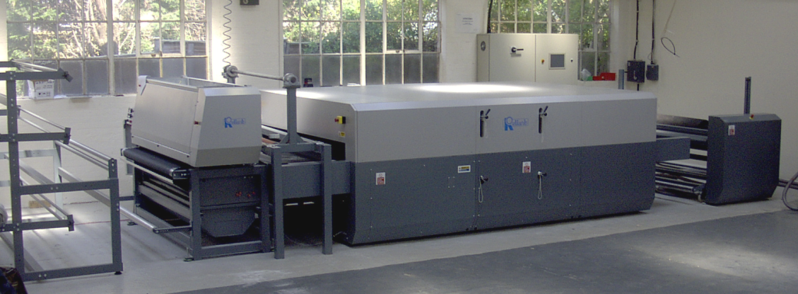
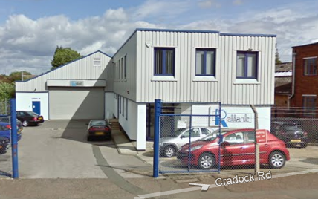
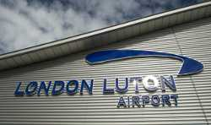
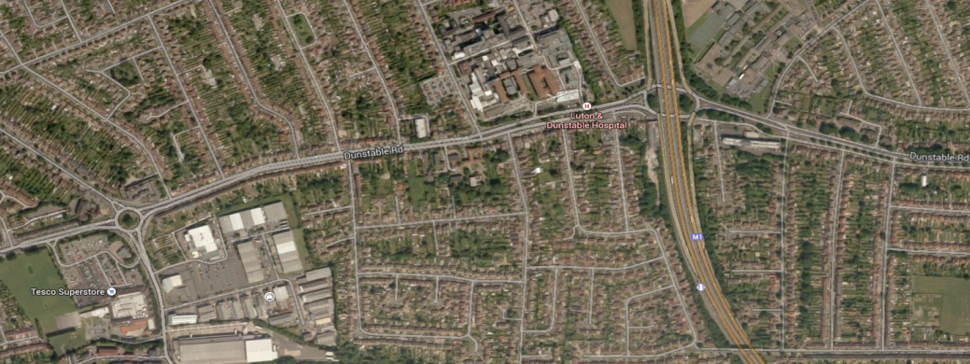
Testing Facilities in our Factory
Testing Line Installed in our Factory in Luton-UK
Luton & Dunstable
Hospital
Junction 11
Dunstable
Tesco
Supermarket
M 1 - North
Powerbond HPC – 2200 mm width – Equipped with: Powder Scatter – Infrared Hood – Unwinders and Rewinders. Suitable for laminating roll to roll or sheets.
Company Profile

Slide 4
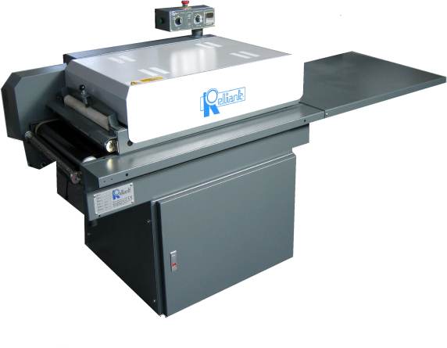
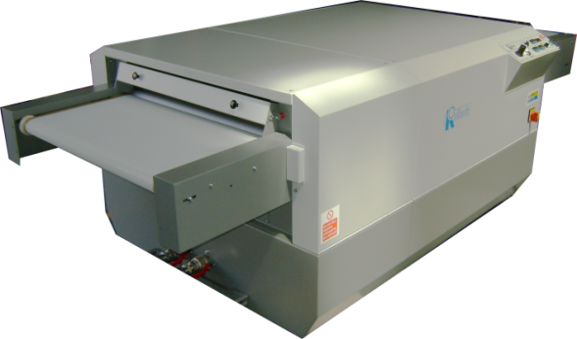
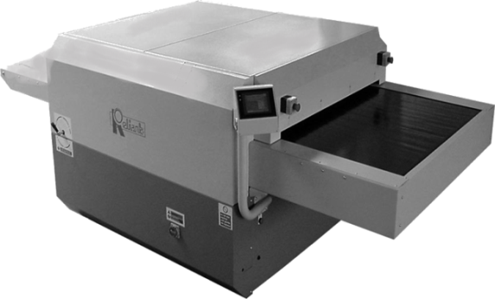
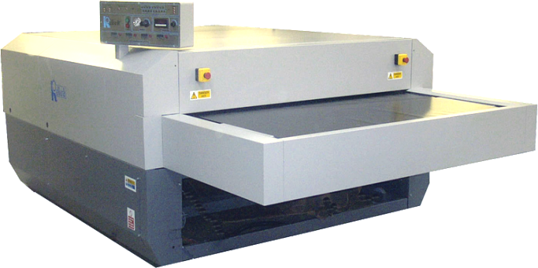
Production Range – Laminating Machines
MiniLam 450
Compact
Magnum GOS
Coolstream GOS
Powerbond and Powerbond HPC
Widths available from 450mm to 3000mm
Company Profile

Slide 5
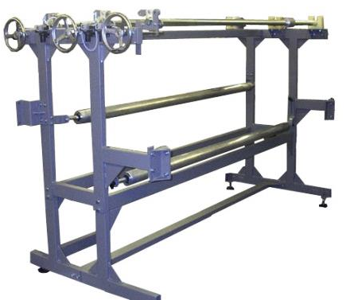
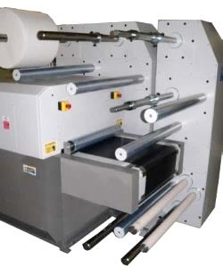
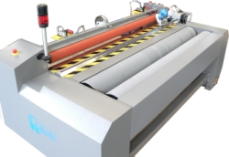
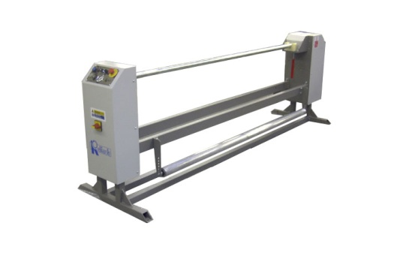
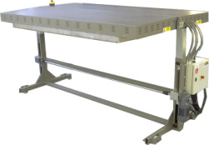
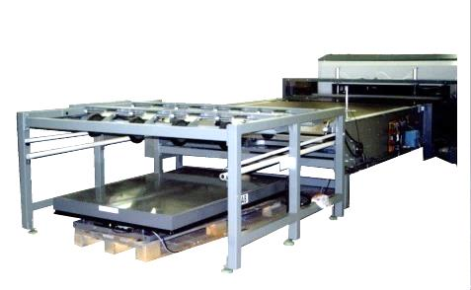
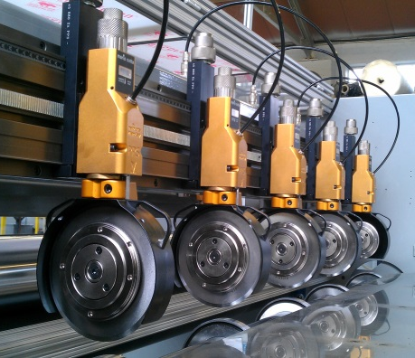
Production Range – Peripherals
Light Weight Winders
Cantilevered Winders
Heavy Weight Winders
Light Weight Rewinders
Infrared Hoods
Powder Coater
Auto-stack units
Slitting & Cross Cutting Systems
Company Profile
Notes:
CUTOUT AMS SLITTER

Slide 6
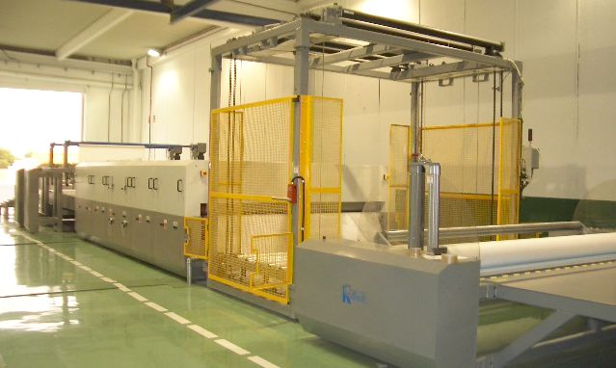
Typical Installation
Powerbond HPC – High Pressure Compression Production Line
Company Profile
Notes:
6

Slide 7
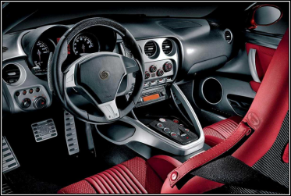
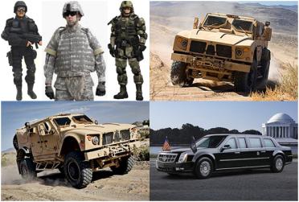
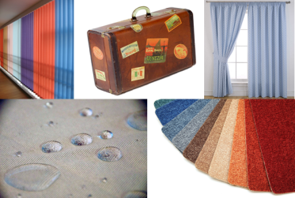
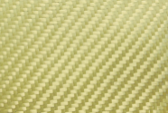
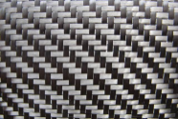
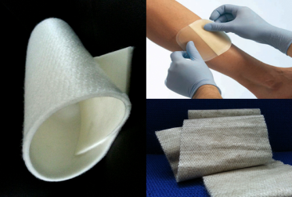
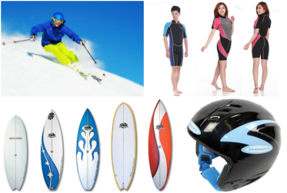
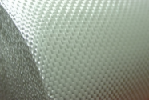
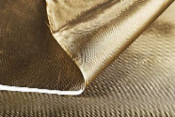
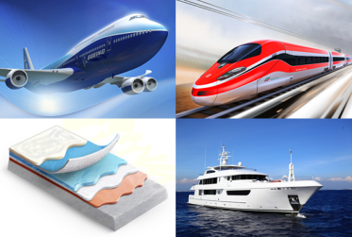
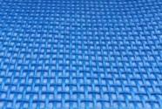
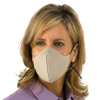
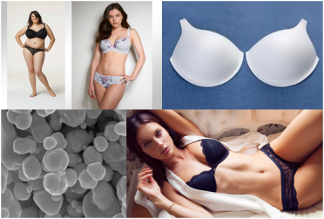
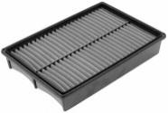
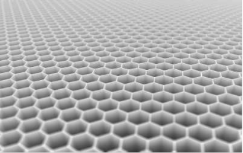
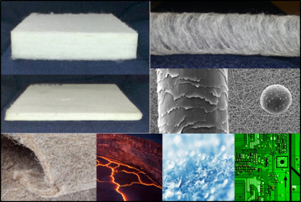
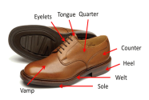
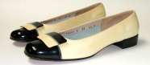
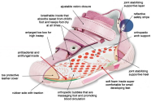
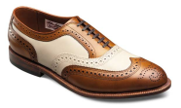
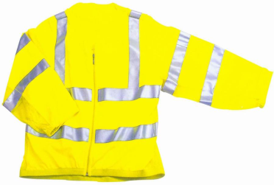
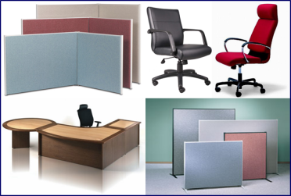
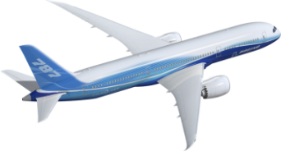
Where Reliant Equipment is Used
Automotive
Defence
Household
Prepregs
Medical
Leisure Industry
Composites
Filtration
Lingerie
Honeycomb
Nonwoven
Footwear
Aerospace
Technical Textiles
Office Furniture
Notes:
7

Slide 8
Flexible Laminating Process
Powerbond HPC – High Pressure Compression Production Line
Powder Scatter
Pressure
Wide Inlet Feed
Heating Zones
Pressure
Cooling Zones
Horizontal flat conveyor run allows flexible and rigid materials to be processed
Conveyors carry the materials through the process completely “stress-free”
Multi-layer processing can be laminated in one pass
Thickness and density can be controlled accurately
Pressure can be applied during the heating and cooling process if required by the tunnel gap setting
Each zone of heating and cooling can be individually pressurized
Single or multiple sets of pressure rollers can be installed
Zone Heating controls allows top and bottom, width and lengthways heating to be controlled independently
Thin and thick materials can be processed
Reel to reel and cut piece processing can be handled
Powder coating, films, webs, PSA’s and other types of adhesives can be applied on continuous webs or sheets
Speed of processing can be varied widely
Company Profile

Slide 9
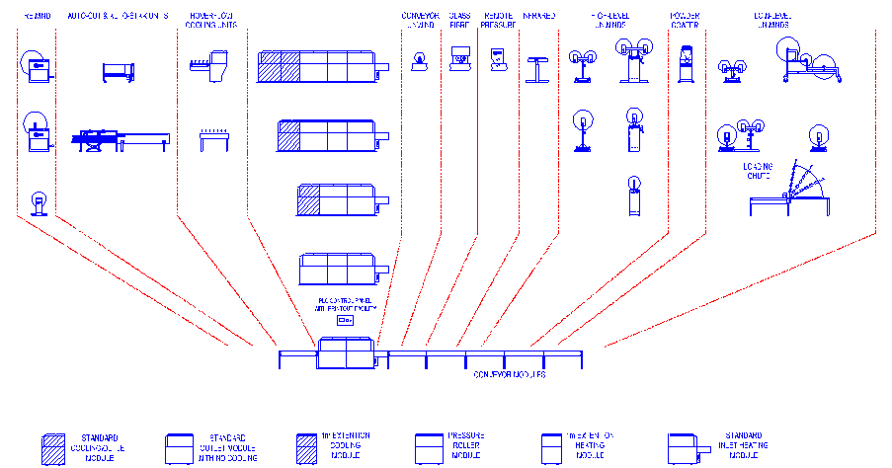
Reliant Unique Modular Concept
Company Profile

Slide 10
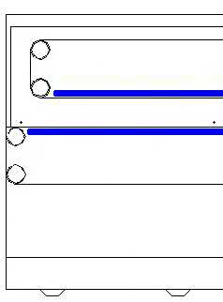
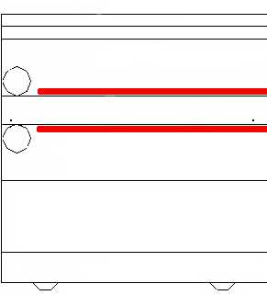
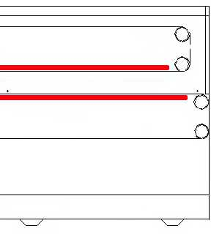
Reliant Unique Modular Concept
NEW
Powerbond Cooling Module
NEW
Powerbond Heating Module
EXISTING Powerbond Heating / Pressure Module
Company Profile

Slide 11
Advantages of Reliant Long Heat Tunnels
Temperature
Adhesive Line Temperature
Temperature Difference
Substrate Temperature
Adhesive Line Level
Retained
Heat Zone
Adhesive Line Temperature
Substrate Temperature
Standard Processes
Heat Tunnel Length
Reliant Machines
Company Profile

Slide 12
Laminating Technologies - Thermofilms
A thermoplastic, or thermo softening plastic, is a polymer that becomes pliable or mouldable above a specific temperature, and returns to a solid state upon cooling.
Examples of thermo softening plastics: EVA, CoPa, CoPES films and webs …
Substrate 1
Adhesive
Substrate 2
Technology – Process

Slide 13
Laminating Technologies - Thermofilms
Viscosity Decreases
Softening
Liquid
Thermoplastic
Solidification Crystallisation
Wetting Substrates
Cooling
Technology – Process

Slide 14
Laminating Technologies - Thermosettings
Thermosetting polymer is defined as a pre-polymer in a soft solid or viscous state that changes irreversibly into an infusible, insoluble polymer network by curing.
Also known as Crosslinking Adhesives or Thermosetting Plastic.
Substrate 1
Adhesive
Substrate 2
Technology – Process

Slide 15
Prepregs Lines
Powder Matrix
Release Paper
Prepreg
Reinforcement
Film Matrix
Release Paper
Prepreg
Reinforcement
Technology – Process

Slide 16
Prepregs Lines
Reinforcement
Matrix Film
Old Release Paper
New Release Paper
Prepreg
Matrix Film
Old Release Paper
Powder Matrix
HT and HP Module
Release Paper
Reinforcement
Prepreg
Technology – Process

Slide 17
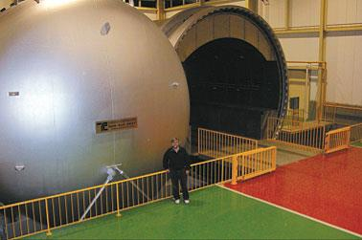
Curing Processes – Autoclaves
Fuji Heavy Industries - Nagoya, Japan) 7m by 7m autoclave required to cure the centre wing box capable of 139 psi/9.6 bar pressure and temperatures up to 400°F/204°C during the eight-to nine-hour cure cycle.
Technology – Process

Slide 18
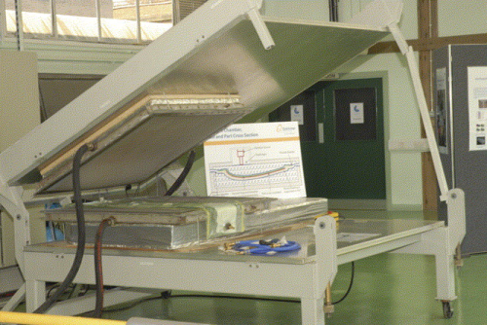
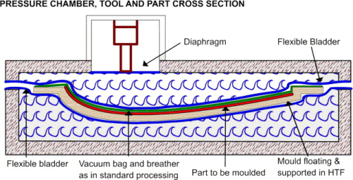
Curing Processes - OOA
The Quick Step Curing Chamber www.quickstep.com.au - Australia
Rapidly applying heat to the laminate, placed between a rigid or semi rigid mould
Mould and laminate separated from the circulation HTF by a flexible membrane
Use of balanced pressure and vacuum on the laminate to cure the part
Economical construction due to low pressure in both chambers (up to 0.8 bar)
Technology – Process

Slide 19
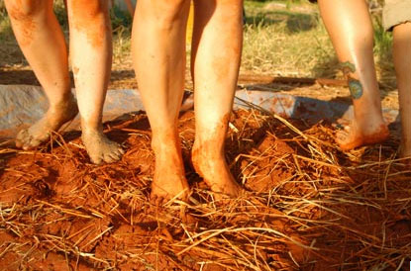
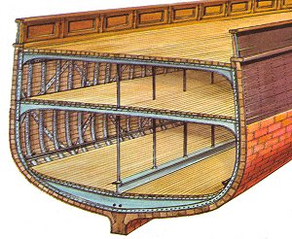
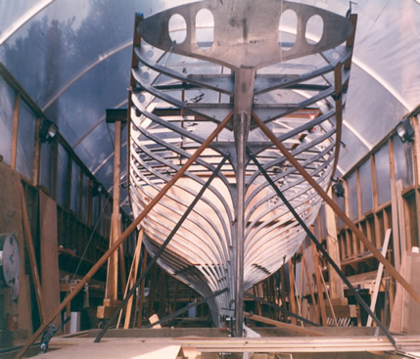
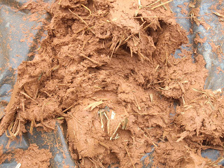
Where Reliant Equipment is Used - Composites
Wood and Metal Hull
Mud and straw bricks
Genghis Khan
Bow and Arrow
History – Composites

Slide 20
Aerospace Industry Over the Years
Composite materials maximise weight reduction – as they typically are 20 per cent lighter than aluminium – and are known to be more reliable than other traditional metallic materials, leading to reduced aircraft maintenance costs, and a lower number of inspections during service. Additional benefits of composite technologies include added strength and superior durability for a longer lifespan.
Aerospace Industry Over the Years

Slide 21
Aerospace Industry Over the Years
Miscellaneous
Steel
Titanium
Aluminium
Composites
1969
1982
1993
2005
1%
3%
11%
50%
Boeing 747
Boeing 757 / 767
Boeing 777
Boeing 787
COPYRIGHT © 2005 THE BOEING COMPANY
Aerospace Industry Over the Years

Slide 22
Aerospace Industry Over the Years
Carbon Laminate
Carbon Sandwich
Other Composites
Aluminium
Titanium
50% Composites - About 55 tons per aircraft
Boeing 747
Boeing 777
1982 = 3%
2005 = 50%
Boeing 757 / 767
Boeing 787
1969 = 1%
1993 = 11%
COPYRIGHT © 2005 THE BOEING COMPANY
Aerospace Industry Over the Years

Slide 23
Aerospace Industry - Seating
No more sewing stitches
Aerospace Industry

Slide 24
Aerospace Industry - Seating
Advantages
X
Weight Saving
Biological
Aesthetic
Efficiency
Weight Saving Advantage
By using our lamination systems (with films – webs - powder adhesives), lighter non-woven’s and/or thinner foams can be used to achieve the same level of stiffness required, therefore providing significant weight savings for each seat produced.
Biological Advantage
Using our laminating systems, fully upholstered, flexible and removable seat covers can be produced which can easily be hygienically cleaned and refitted to the seat. The lamination of barrier and breathable membrane films can also be introduced to provide additional biological benefits.
Aesthetic Advantage
Using our laminating systems, a softer, more comfortable, and modern design of seat can be achieved. The introduction of laminating, allows materials such as leather to be more easily used and also integrated with non woven’s and other materials to achieve design features.
Efficiency Advantage
Using our laminating systems will reduce the number of sewing operations needed to produce a seat and will provide significant manufacturing cost savings. Additional features such as flame retardant adhesives can also easily be incorporated with suitable non-woven’s by the lamination process.
Aerospace Industry

Slide 25
High Performance Insulation
Combination of fibres such as glass, aramids / Kevlar ®, AES, RCF and others, provides the most effective insulation at temperatures ranging from MINUS 190° C to 1600° C.
Examples of fibres and level of protection:
Glass = 500° C
Mineral Fibre = 850° C
AES fibre = 1100 - 1300° C
RCF fibre = 1300 – 1400° C
Alumina fibre = 1550° C
Insulation

Slide 26
High Performance Nonwoven
Construction
Fibres
Fillers
Spunlacing
Aramids / Kevlar ®
Gels, waxes, solids
Needlepunch
Glass
Minerals
Staple
Combinations with:
AES - Alkaline Earth Silicate Wool
Hydroentangling
Carbon Fibre
RCF - Refractory Ceramic Fibre
V-Lap (Horizontal)
Metallic Coated Fibres
Spacer or 3D
Nanofibre
Alumina Fibre
Insulation

Slide 27
High Performance Insulation
EMI Shielding
RFI Shielding
Static Dissipation
Radar Signature Management
Electrical & Thermal Conductivity
Dielectric
Corrosion & Chemical Resistance
Abrasion Resistance
Insulation

Slide 28
High Performance Nanofibre
Properties of Nonwoven from Nanofibres:
Low density of nanofibres
Small pore size
High porosity – good breathability
Large specific surface area of nanofibres
Possibility to incorporate different additives
Excellent mechanical properties in proportion to weight
The thermal insulating efficiency of fibre-based insulation is known to increase as the fibre size is reduced!
Human Hair
Pollen
Nanofibre
Insulation
Copyright www.elmarco.com

Slide 29
High Performance Nanofibre
Main Applications:
Air filtration
Depth air filtration
HVAC reference filter
Liquid filtration
Performance apparel
Acoustic
Medicine
Battery separators
Human Hair
Pollen
Nanofibre
Insulation
Copyright www.elmarco.com

Slide 30
Core Materials - Honeycomb
Sandwich core materials
Homogeneous support of
the skins
Foam cores
Structured (non-homogeneous) support of the skins
Best Material Properties
Punctual
support
Textile/pin cores
Regional
support
Cup shaped cores
Unidirectional support
Corrugated cores
Bi-directional
support
Honeycomb cores
Sandwich Core Materials

Slide 31
EconCore’s – Economic Core Technologies
Core Materials - Honeycomb
Aerospace Industry
New Honeycomb Cores
ThermeHex
Thermoplastic Honeycomb
Packaging Industry
Production principle & technology
Internal structure
and properties
Excellent mechanical properties
Very low weight
Automated production
Low production costs
Automated in-line production leading to very low production costs
Direct lamination of skins allows in-line production of panels
Sandwich Core Materials – Technology

Slide 32
Sandwich Materials - Honeycomb
PP-panel materials made in
continuous automated production
Honeycombs with minimal use
of material and best performance
PP-Twin sheet
(fluted board)
Extruded PP-honeycombs
PP-cup-shaped board
(bubble board)
ThermHex
honeycomb
Continuously Produced Panels with Honeycomb

Slide 33
Compression and Lamination Combined
Powerbond HPC
Sandwich Core Materials – Technology
Notes:
33

Slide 34
Compression and Lamination Combined
P
O
W
E
R
B
O
N
D
H
P
C
Raw Material
Up to 150 mm thick
Raw Material
Compressed From 1 to 4 mm
Laminated
Isolation Panel
Sandwich Core Materials – Technology
Notes:
34

Slide 35
Compression and Lamination Combined
Spectra® fabric, also known as Ultra High Molecular Weight Polyethylene, is super lightweight, floats naturally on water, has high resistance to chemicals, water, and UV light. It offers a very low coefficient of friction, low dielectric constant, high tenacity, and excellent cut and abrasion resistance
UHMWPE is 15 times stronger than steel, and 40 percent lighter than aramid fibres on a per weight basis.
Sandwich Core Materials – Technology

Slide 36
Automotive Sector
ABC Pillar Covers
Car Seat Covers
Acoustic Products
Carpet Compounds
Leather Components
Headliners Assembly
Door and Boot Panelling
Insulating Constructions
Automotive Sector
Notes:
36

Slide 37
Automotive Sector – High Pressure Compression
Isolation Products
Carpet Compounds
Headliners Assembly
Door and Boot Panelling
Steel and Aluminium Trim Parts Replacement
Pre-Lamination for Moulded Parts
Lamination and Compression of Composites for Interior and Exterior Components
Automotive Sector

Slide 38
Renewable Resources – Bio Composites
Sisal
Flax
Abaca
Hemp
Coconut
Cashew
Sugar Cane
Corn
Cork
Soya
Renewable Resources – Bio Composites

Slide 39
Renewable Resources – Bio Composites
The race car is made from:
Woven flax & carrot pulp
Recycled carbon fibre
Recycled resin
It uses biodiesel
Lubricated with plant oils
COPYRIGHT Warwick University
Renewable Resources – Bio Composites

Slide 40
Compressed Recycled Fibres
Compressed Recycled Fibres

Slide 41
Aramids / Kevlar ® Fibre
Multiaxial Aramid
Aramid Yarn
Aramid Woven Fabric
Unidirectional Aramid
Aramids / Kevlar ® Fibre

Slide 42
Defence Industry
Defence Industry

Slide 43
Recycled Tyres Matt
The target – Economical, highly profitable and environmentally friendly system to produce rubber and fibre sheets or continuous rolls from recycled car and truck tyres.
Recycled Tyres Matt

Slide 44
Rubber & Fleece Bonding System
Scattering
Compression, Bonding and Laminating
Optional
Sheet Cutting
and / or
Rewinder
Blending System
Powerbond HPC-RT
Recycled Tyres Matt

Slide 45
Recycled Tyres Matt – Advantages
Highly flexible
Noise dampening
Shock absorbing
Insulating
Protecting
Sealing
Recycled Tyres Matt

Slide 46
Recycled Tyres Matt – Uses
Some applications for rubber and fleece matt
Building
Roofing
Flooring
Plumbing
Civil engineering
Public transportation
Automotive
Packaging
Sports
Recycled Tyres Matt

Slide 47
Office Furniture
Wall and divider panelling
Chairs
Carpeting
Window and divider blinds
Where Reliant Machines Is Used

Slide 48
Household
Curtains and blinds
Underlay backing for carpets
Tuft lock for carpets
Floor tiles
Waterbeds and beds upholstery
Mattress Ticking
Cleaning cloth
Table mats
Luggage linings and dividers
Recycled Tyres Matt

Slide 49
Filtration
Compounds for air filtration
Compounds for liquid filtration
NBC defence materials
Hydraulic, fuel, lubrication and air systems
Medical devices, filtration papers, purification, wicking and emanation
Electronics and pharmaceutical
Where Reliant Machines Is Used

Slide 50
Technical Textiles
Reflective tape
Lining fabrics
Foams (PU, PE’s, Polystyrene, etc.
Leather
Padding
PP woven and nonwovens
Knitted fabrics
Lycra, nylon
Breathable films and fabrics
Where Reliant Machines Is Used

Slide 51
Medical
Porous and non-porous plasters and bandages
Breathable fabrics and elastics
Foot padding, supports and mouldings
Filters
Hydrophilic and hydrophobic laminates
Breathable films and membranes
Anti-microbial dressings
Where Reliant Machines Is Used

Slide 52
Leisure Industry
Diving suits and board bags
Breathable sportswear
Body and head protectors
Floor Mats
Where Reliant Machines Is Used

Slide 53
Lingerie
Reliant Sure-Bra Laminating system for moulded bra cups
Stretch fabrics and films for all types of lingerie applications
Laminating and folding systems for straps
Sew free processing for bras and other garments using powder film and web adhesive system
Where Reliant Machines Is Used

Slide 54
Shoe Industry
Laminated uppers and soles for sport shoes
Linings, insoles and supports
Calibration of fibres
Leather and Synthetic materials
Production of all types of footwear is produced on Reliant laminators. From leather uppers and heal supports to rubber insoles and soft constructions with antibacterial chemicals.
Where Reliant Machines Is Used

Slide 55
Real Vision in
Laminating Technology
Thank you!!!
Reliant Machinery USA
1836, E. Ontario Street
Philadelphia – PA – 19134 – USA
Tel: +1 215 6342626
sales@reliantmachineryusa.com
Reliant Machinery UK
Unit L, Cradock Road – Luton
Bedfordshire – LU4 0JF – UK
Tel: +44 1582 584999
sales@reliant-machinery.co.uk

